Slide 1
Atlas Itinerary
By Gabriel Taylor, Dustin Zook, Sorelle Djuissi, Gabriyel Sorensen

Slide 2
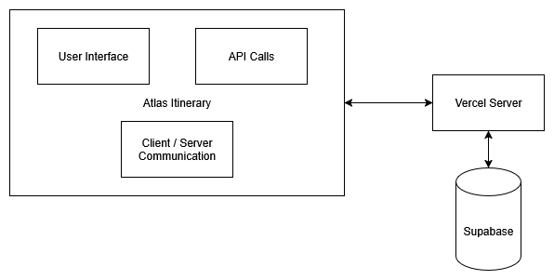
Block Diagram

Slide 3
Storyboard

Slide 4
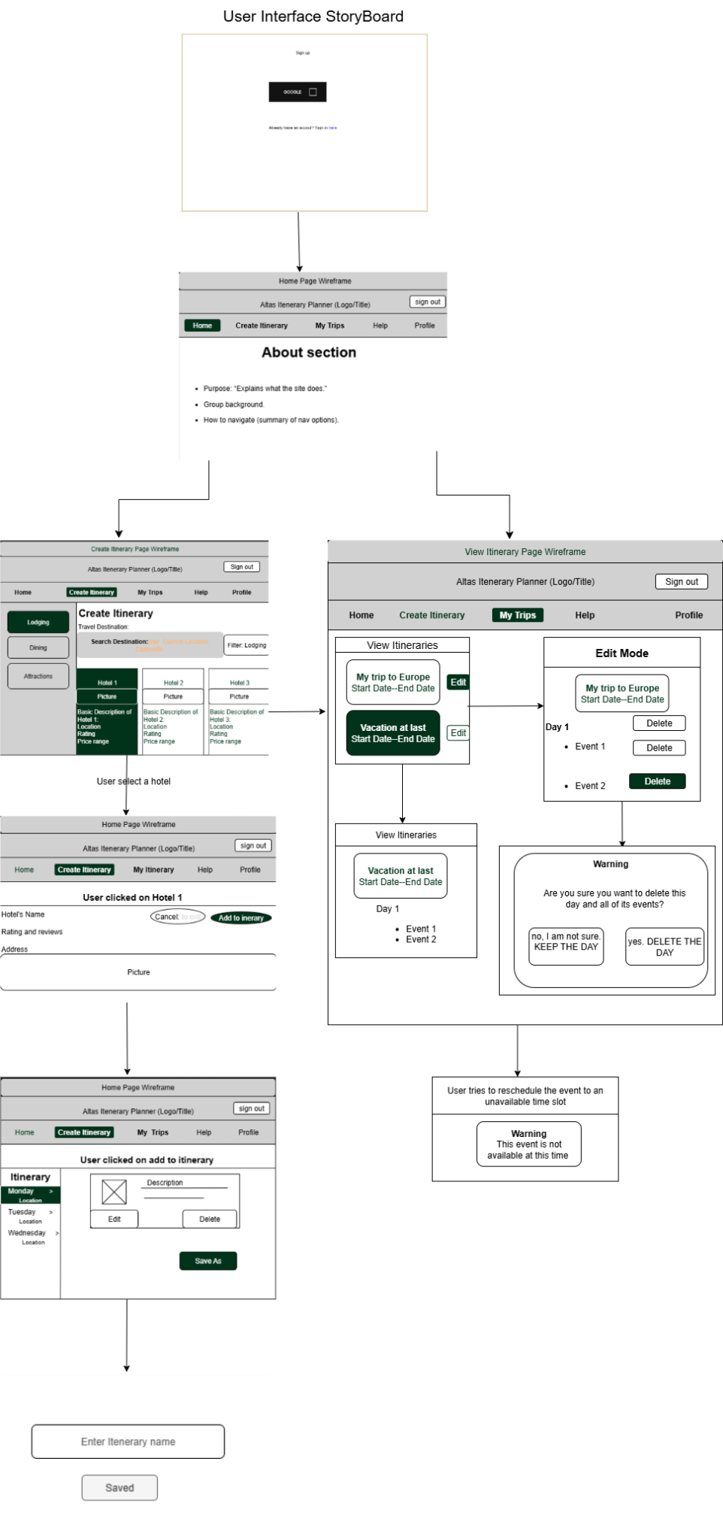

Slide 5
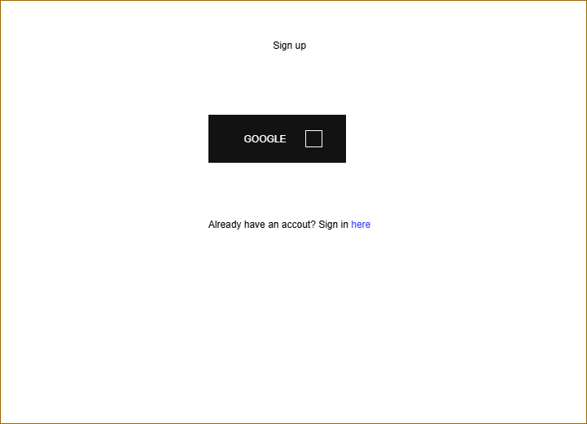
Sign-up and sign in page
Google API backbone
Link to Sign-in page

Slide 6
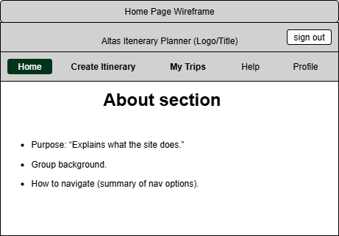
The Home Page
About Section
Instructions
Personnel
Nav Bar

Slide 7
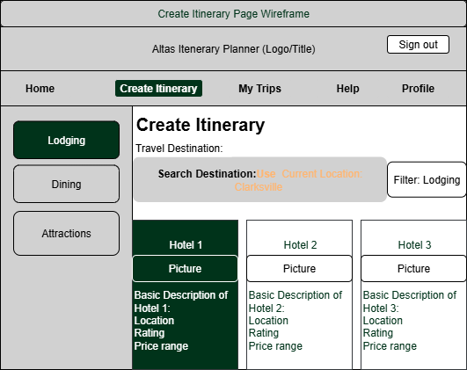
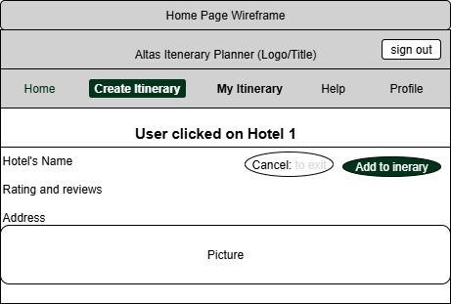
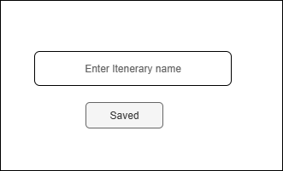
Create Itinerary
Travel destination
Geolocating
Location categories
Subcategories in the filter
Successful Completion

Slide 8
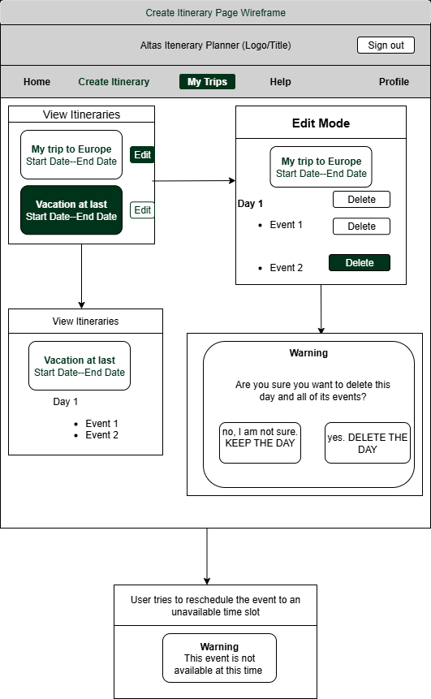
View Itinerary
Empty Page
Card Presentation (and Contents)
Expanded cards
Edit mode (both event and day)
Warning

Slide 9
The Components

Slide 10
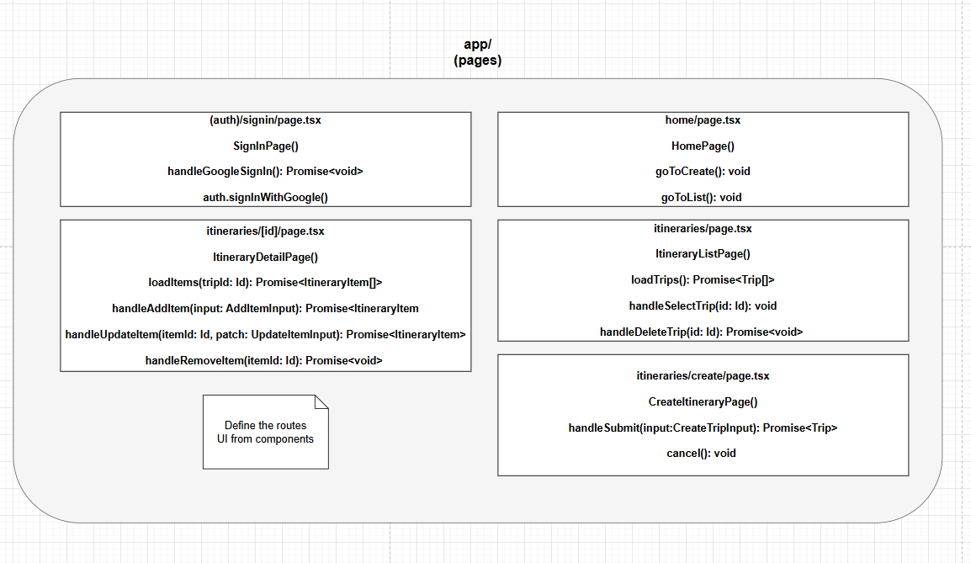

Slide 11
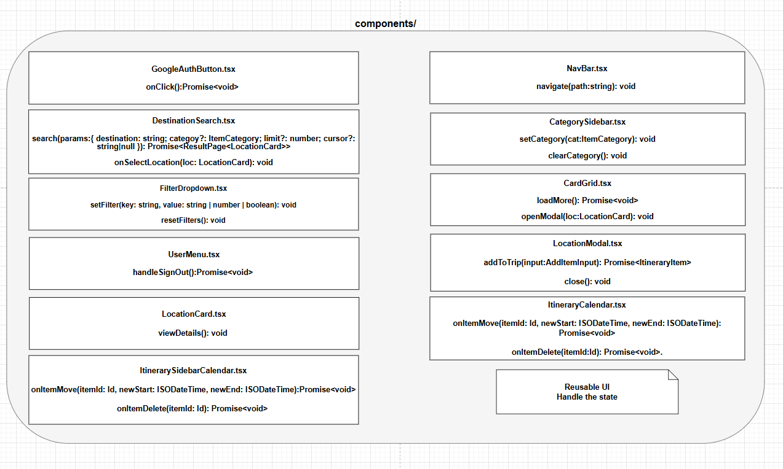

Slide 12
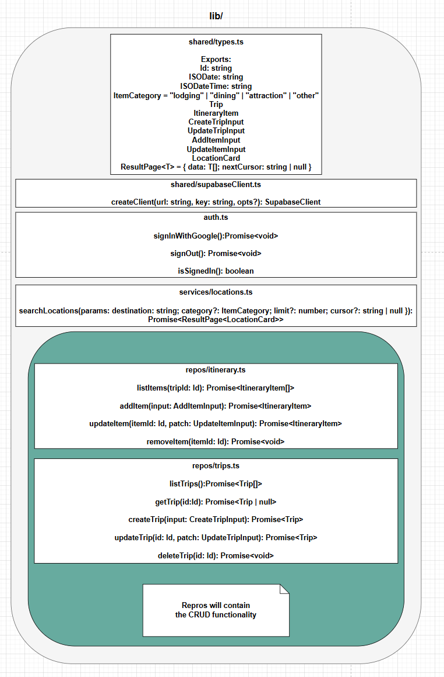

Slide 13
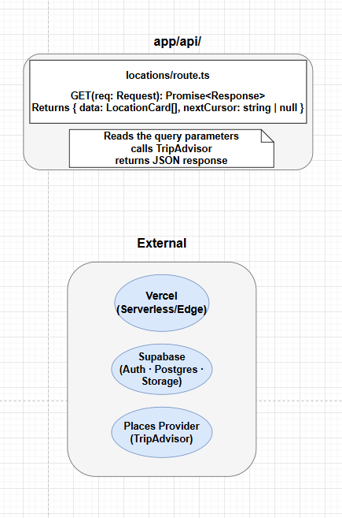

Slide 14
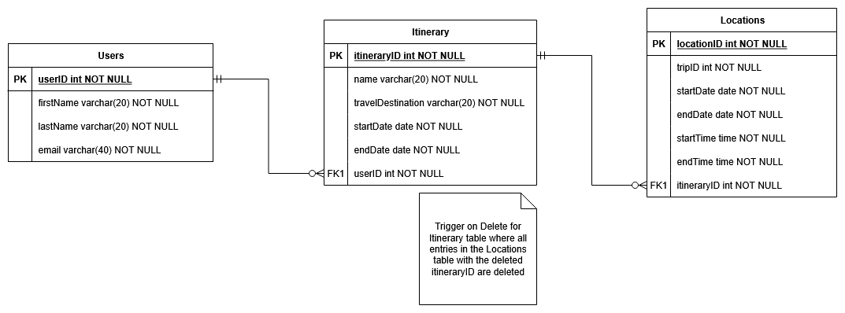
Storage Documentation - ER Diagram

Slide 15
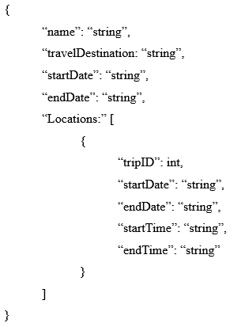
Message Documentation - Save Itineraries

Slide 16
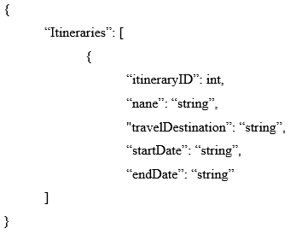
Message Documentation - View Itineraries

Slide 17
Questions?

